Slide 1

Lecture 10:
Layout & Stick Diagrams

Slide 2
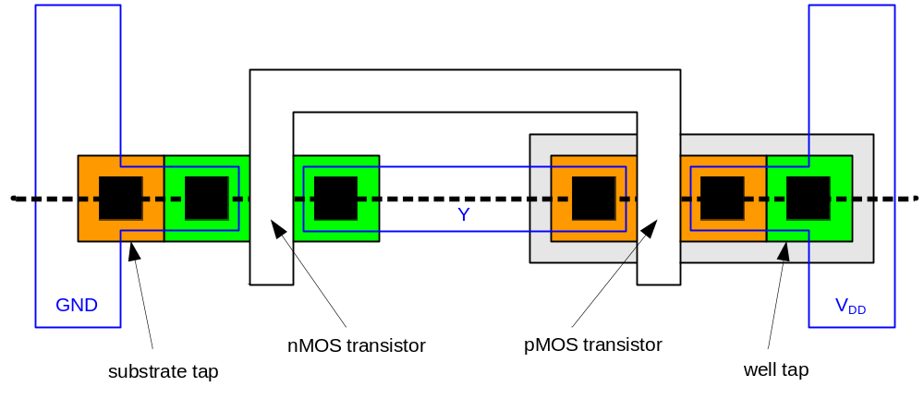
Inverter Top View
Transistors and wires are defined by masks
Cross-section taken along dashed line
0: Introduction

Slide 3
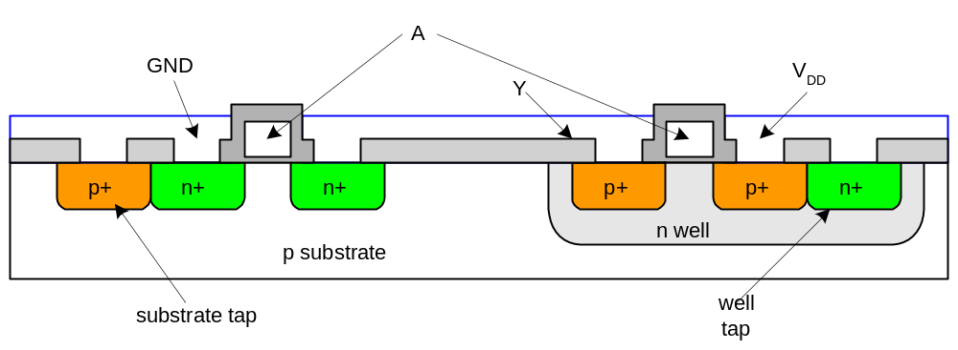
Inverter Cross-section
Substrate must be tied to GND and n-well to V_{DD}
Metal to lightly-doped semiconductor forms poor connection called Shottky Diode
Use heavily doped well and substrate contacts / taps
0: Introduction

Slide 4
Gate Layout
Layout can be very time consuming
  Design gates to fit together nicely
  Build a library of standard cells
Standard cell design methodology
  V_{DD} and GND should abut (standard height)
  Adjacent gates should satisfy design rules
  nMOS at bottom and pMOS at top
  All gates include well and substrate contacts
1: Circuits & Layout

Slide 5
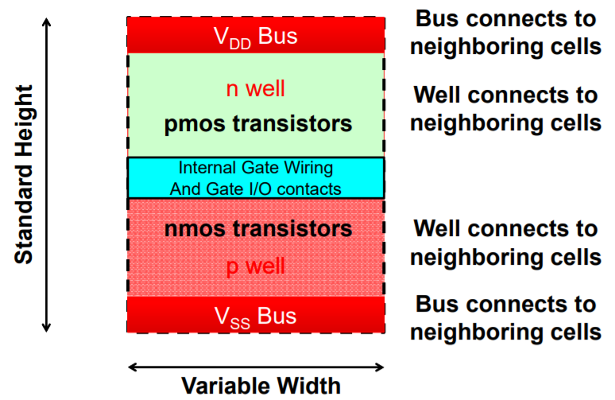
Standard Cell Layout
1: Circuits & Layout

Slide 6
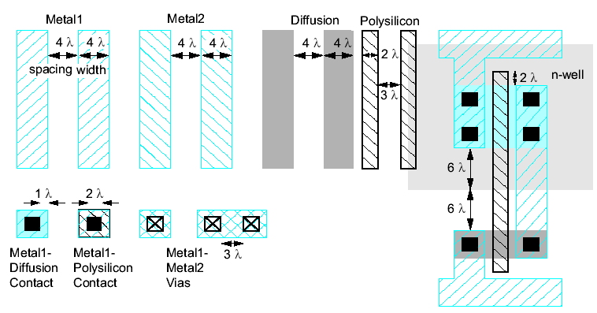
Simplified Design Rules
Conservative rules to get you started
0: Introduction

Slide 7
Source and Drain
We will follow the convention: current always flows from top to bottom in an electronic circuit
  For pMOS transistor:
    Carrier: holes (+)
    Top node: Source
    Bottom node: Drain
  For nMOS transistor:
    Carrier: electrons (-)
    Top node: Drain
    Bottom node: Source
1: Circuits & Layout

Slide 8
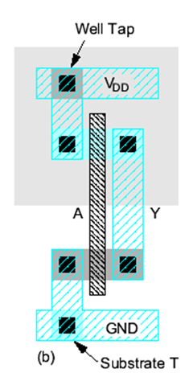
Example: Inverter
1: Circuits & Layout

Slide 9
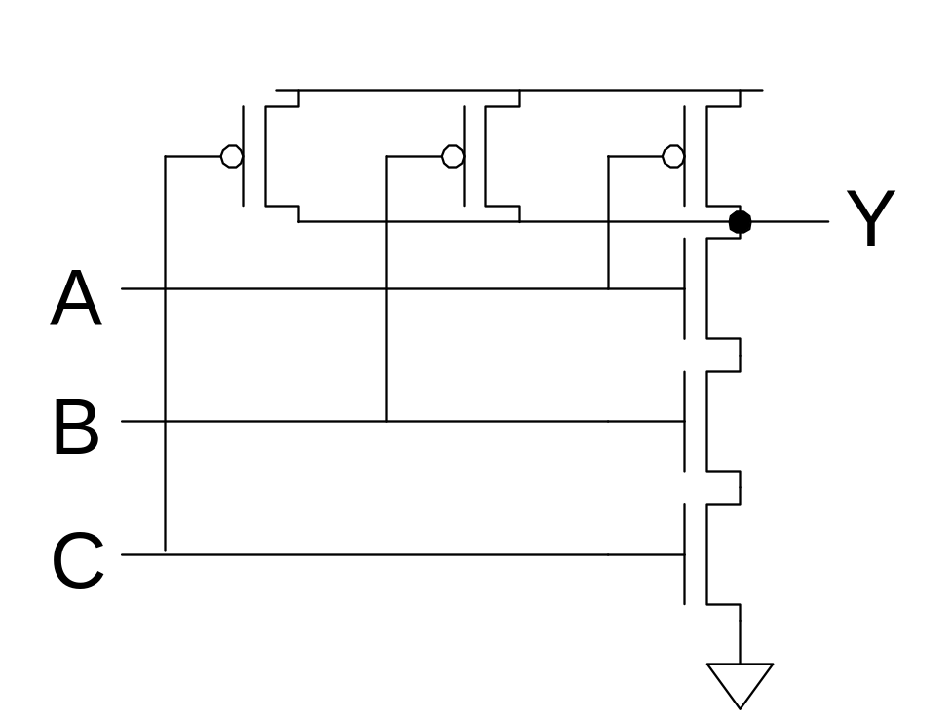
3-input NAND Gate
Y pulls low if ALL inputs are 1
Y pulls high if ANY input is 0
0: Introduction

Slide 10
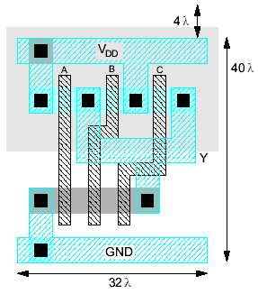
Example: NAND3
Horizontal N-diffusion and p-diffusion strips
Vertical polysilicon gates
Metal1 V_{DD} rail at top
Metal1 GND rail at bottom
32 λ by 40 λ
1: Circuits & Layout

Slide 11
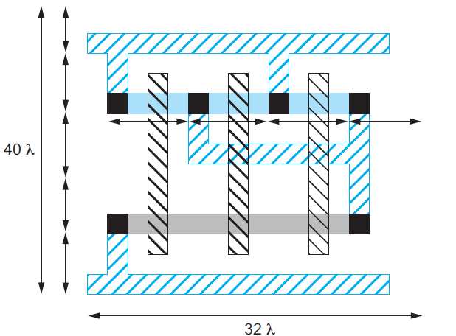
Example: NAND3
1: Circuits & Layout

Slide 12
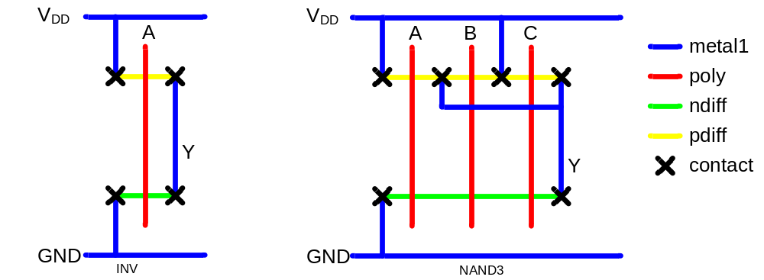
Stick Diagrams
Stick diagrams help plan layout quickly
  Need not be to scale
  Draw with color pencils or dry-erase markers
1: Circuits & Layout

Slide 13
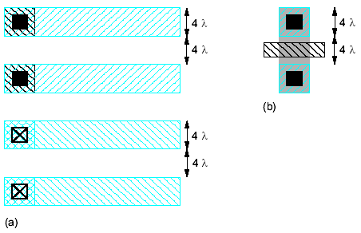
Wiring Tracks
A wiring track is the space required for a wire
  4 λ width, 4 λ spacing from neighbor = 8 λ pitch
Transistors also consume one wiring track
1: Circuits & Layout

Slide 14
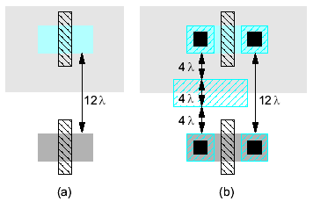
Well spacing
Wells must surround transistors by 6 λ
  Implies 12 λ between opposite transistor flavors
  Leaves room for one wire track
1: Circuits & Layout

Slide 15
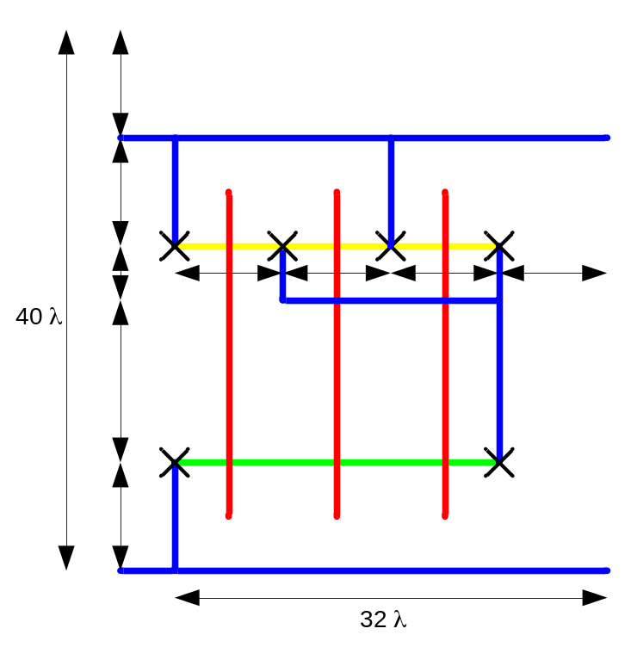
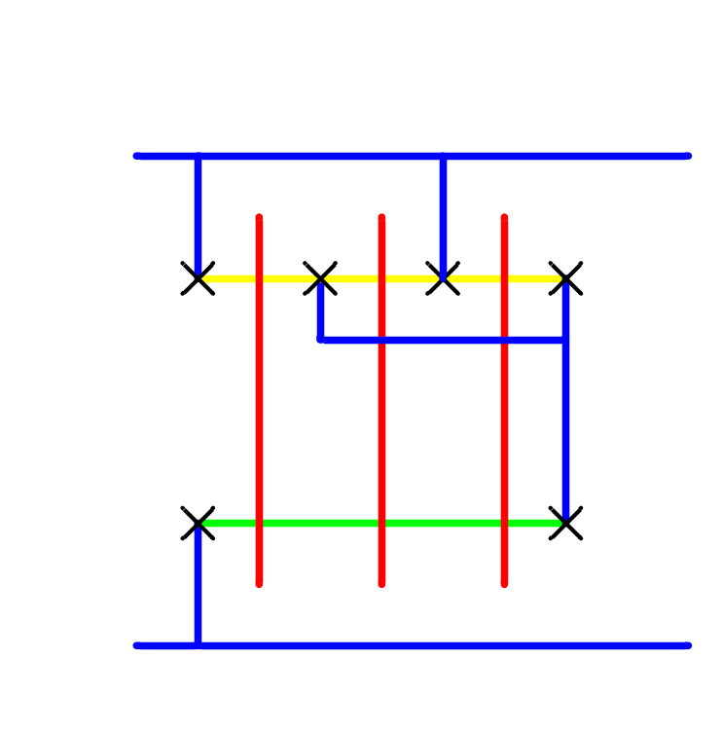
Area Estimation
Estimate area by counting wiring tracks
  Multiply by 8 to express in λ
1: Circuits & Layout

Slide 16
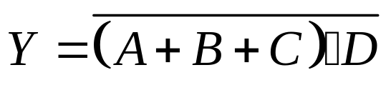
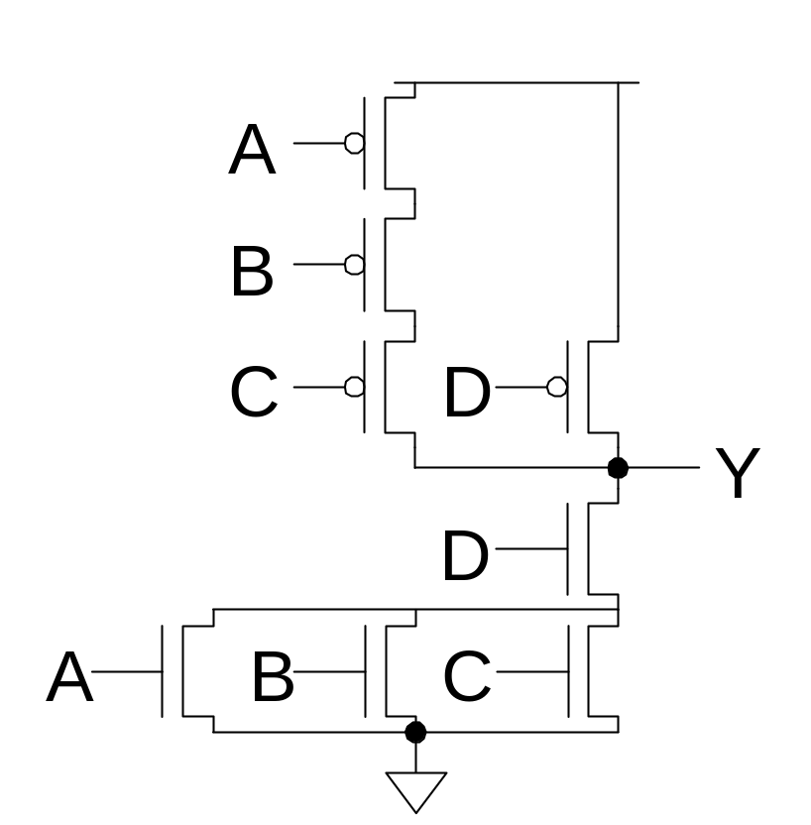
Example: O3AI
1: Circuits & Layout

Slide 17
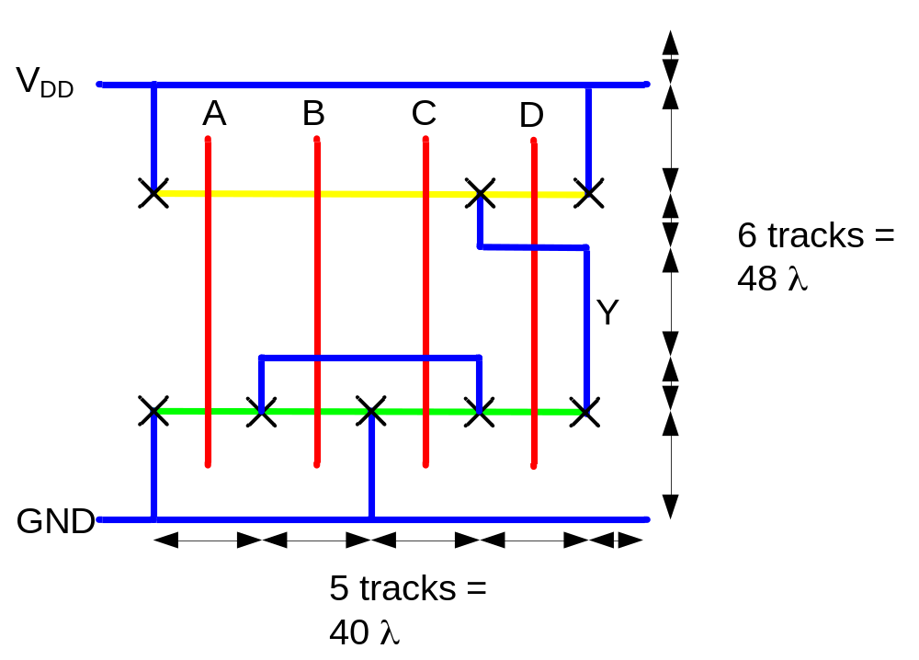
Example: O3AI
Sketch a stick diagram for O3AI and estimate area
1: Circuits & Layout

Slide 18
Example: NOR4
1: Circuits & Layout

Slide 19
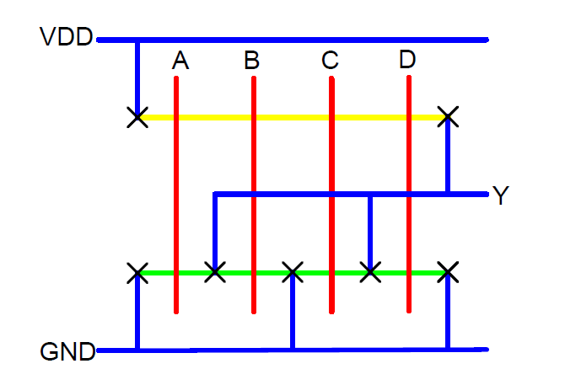
Example: NOR4
1: Circuits & Layout

